Slide 1
NeRF
Neural Radiance Fields
Technical University of Munich
Presenter: Sebastian Lederer
Supervisor: Hanzhi Chen & Simon Schaefer
January 15th, 2024

Slide 2
Introduction
Sebastian Lederer

Slide 3
1.
Introduction
2.
Neural Radiance Fields (2020)
3.
Plenoxels (2021)
4.
Instant Graphics Primitives (2022)
5.
Summary & subsequent work
6.
Personal Opinion
Sebastian Lederer

Slide 4
1.
Introduction
2.
Neural Radiance Fields (2020)
3.
Plenoxels (2021)
4.
Instant Graphics Primitives (2022)
5.
Summary & subsequent work
6.
Personal Opinion
Sebastian Lederer

Slide 5
General Idea
Neural Radiance Fields
Sebastian Lederer
Notes:
Bunch of different input images from different view angles ca 80-100
Train model
Synthesize new scenes and videos

Slide 6
Network Architecture
Neural Radiance Fields
Specific coordinate & viewing angle
Color & density
Overfit Neural Network to particular scene!
Sebastian Lederer
Notes:
Input pixel X
Input viewing angle
Fully connected Network 9 layers, MLP (no complicated architecture)
Give me the color and the volume density -> Is there something there
Condense information of all different viewing angles into the paraemters of one neural network
Very costly

Slide 7
Complete Picture
Neural Radiance Fields
Sebastian Lederer
Notes:
Full picture
Input images -> ray sample coordinates -> in beginning we don’t know anything
Send to network and get rbg + density (garbage in beginning), many ray (per pixel)
Traditional rendering
Go Along ray and ‘integrate’ colors
For training we need some way to backpropagate, NN figure out color and intensity

Slide 8
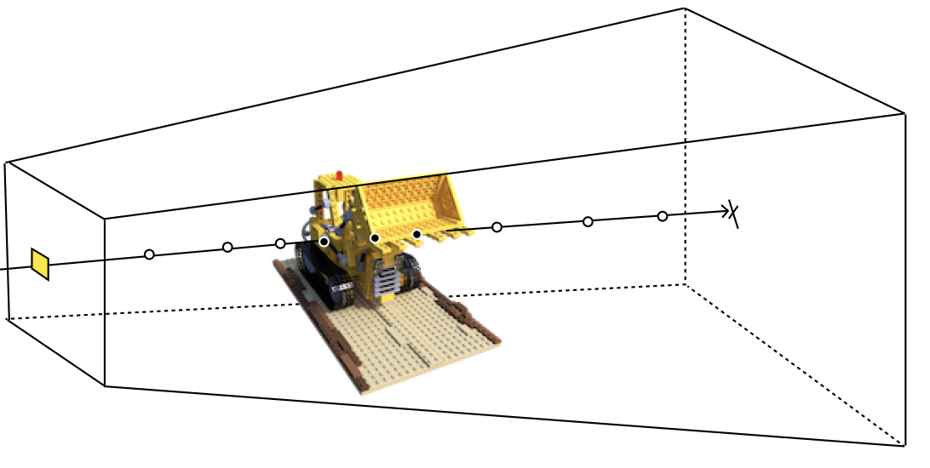
Volume Rendering
Neural Radiance Fields
Color ray
Color * Density at X from viewing angle d
Will light ray reach t?
Sebastian Lederer
Notes:
Volume Rendering
Traditional volume rendering (80s) not specific to nerf, but differentiable

Slide 9
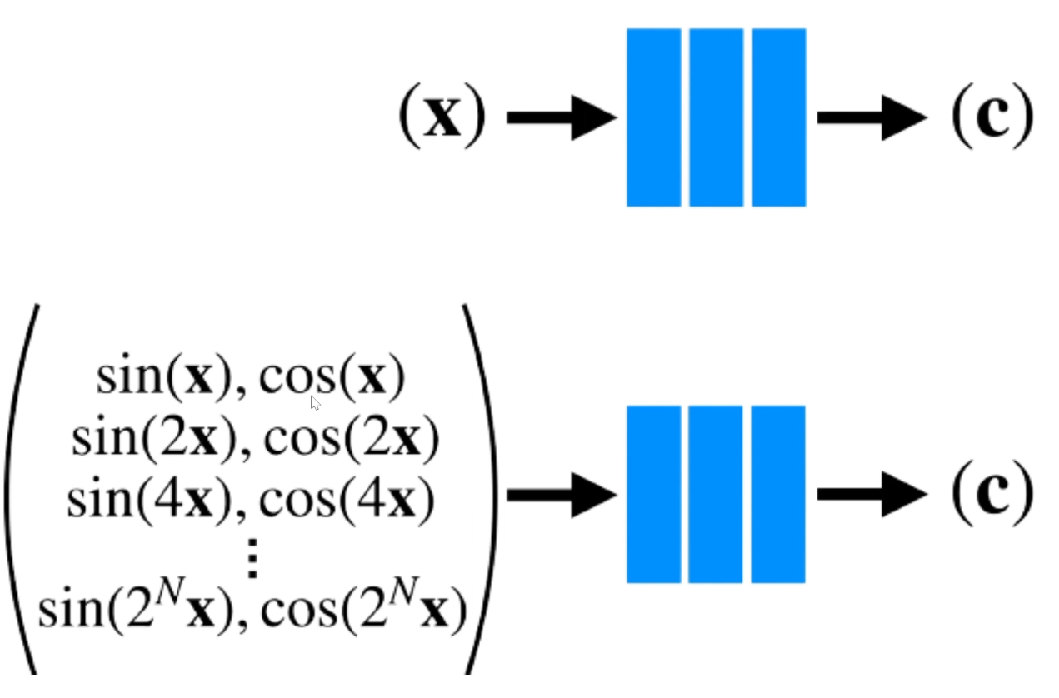
Positional Encoding
Neural Radiance Fields
Sebastian Lederer
Notes:
Positional encoding
Small changes in input x will generate small input in y if we
continuous function
Transformation before sending to network
Higher dimensional space
Can pick up better details
Separate paper why this works

Slide 10
Results
Neural Radiance Fields
Sebastian Lederer
Notes:
Results
Specular reflections
Problem slow

Slide 11
1.
Introduction
2.
Neural Radiance Fields (2020)
3.
Plenoxels (2021)
4.
Instant Graphics Primitives (2022)
5.
Summary & subsequent work
6.
Personal Opinion
Sebastian Lederer

Slide 12
Complete Picture
Plenoxels
& Density
Sebastian Lederer
Notes:
Radiance fields without neural network
Similar performance 100x faster 10 min 1 day
Every step is differentiable -> so you can optimize color values

Slide 13
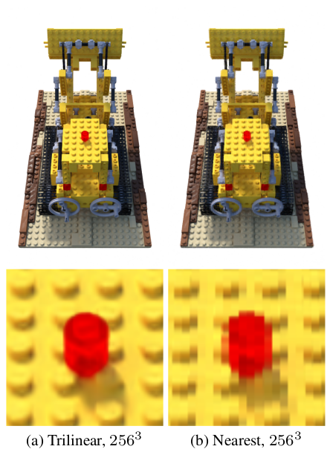
Optimization
Plenoxels
Interpolation
Coarse grid & fine grid
Grid subdivision in areas with high detail
Voxel pruning in empty space
Total variance regularization to clear artifacts
Sebastian Lederer
Notes:
Model becomes sparse very quickly -> Also why this is so fast

Slide 14
Comparison to NeRF
Plenoxels
Sebastian Lederer

Slide 15
1.
Introduction
2.
Neural Radiance Fields (2020)
3.
Plenoxels (2021)
4.
Instant Neural Graphics Primitives (2022)
5.
Summary & subsequent work
6.
Personal Opinion
Sebastian Lederer

Slide 16
Introduction
Instant Neural Graphics Primitives
Sebastian Lederer

Slide 17
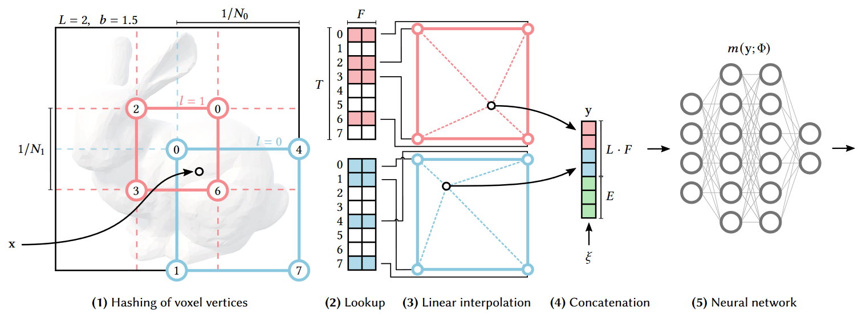
Complete Picture
Instant Neural Graphics Primitives
extra Parameters
Sebastian Lederer
Notes:
Combine Voxel and Nerf approach
Multiple resolutions coarse grid & fine grid
Grid would be to memory big
New idea: hash table of fixed size T, great for gpu task (parallel)
Collision: multiple points will map to same feature, soft collision resolution
Values that minimize loss the most will automatically be prioritized

Slide 18
Comparison Encoding
Instant Neural Graphics Primitives
Sebastian Lederer

Slide 19
Comparison
Instant Neural Graphics Primitives
For Similar Reconstruction Detail | Original NeRF | Plenoxels | Graphics Primitives
Training Time | ~30 h | ~10 min | ~30 seconds
Rendering Time | ~ 1 per min | ~ 1 FPS | ~ 10 FPS
Size | 5 MB | 1 GB | 200 MB
Parameters | 400k | 13M Voxels | 10k + 12M Hashtable
Method | MLP | Voxels | MLP + Hashtable
Sebastian Lederer

Slide 20
1.
Introduction
2.
Neural Radiance Fields (2020)
3.
Plenoxels (2021)
4.
Instant Graphics Primitives (2022)
5.
Subsequent Work
6.
Personal Opinion
Sebastian Lederer

Slide 21
Subsequent Work
Nerf in the Wild (2021)
ZipNERF (2023)
Nerfies (2021)
Sebastian Lederer
Notes:
NICE slam and MegaNerf
New architecture for every problem
Take time until usable in conventional rendering software
Real time constraints
Long way to go, but looking at speed of research

Slide 22
1.
Introduction
2.
Neural Radiance Fields (2020)
3.
Plenoxels (2021)
4.
Instant Graphics Primitives (2022)
5.
Subsequent work
6.
Personal Opinion
Sebastian Lederer

Slide 23
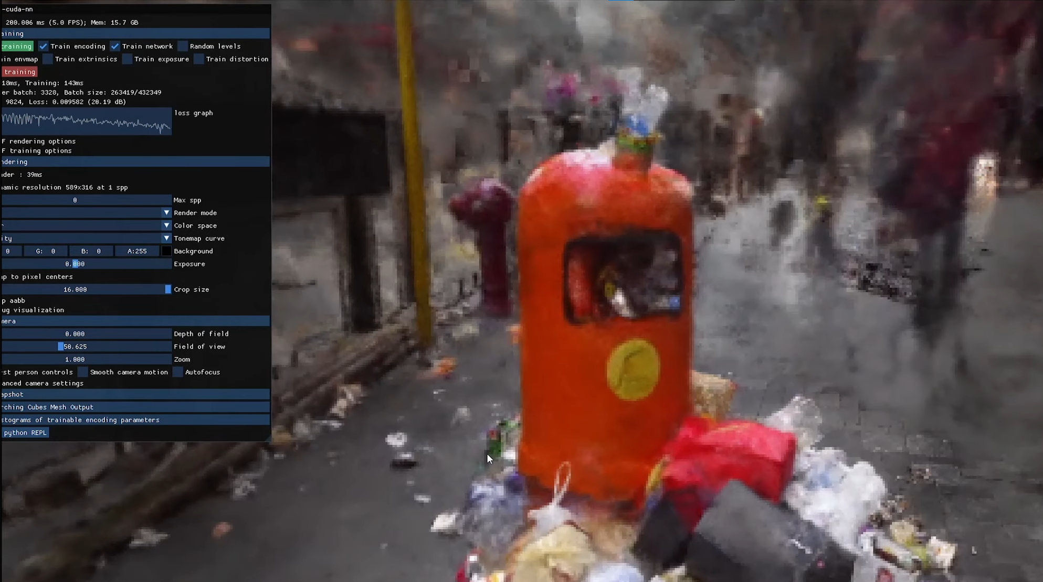
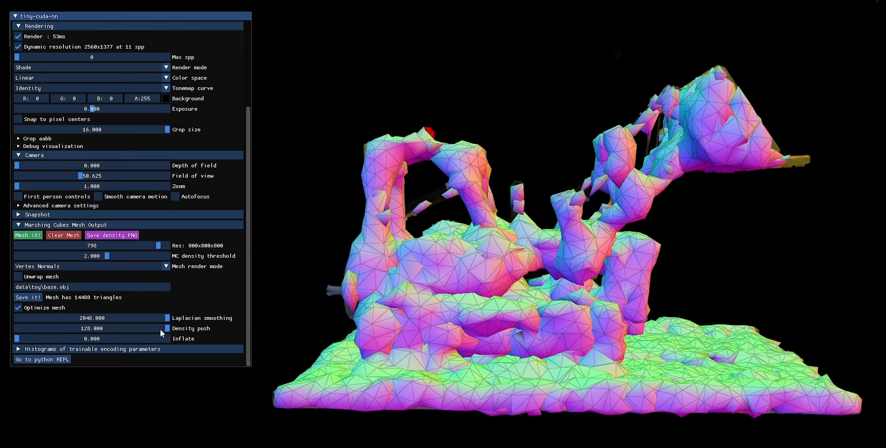
Personal Opinion
Trash Can Reconstruction
Mesh Conversion
Sebastian Lederer

Slide 24
Thank you for listening!
I‘m happy to take your questions.
Technical University of Munich
Presenter: Sebastian Lederer
Supervisor: Hanzhi Chen & Simon Schaefer
January 15th, 2024

Slide 25
Sources
[1]: Mildenhall et Al. (2020), NeRF: Representing Scenes as Neural Radiance Fields for View Synthesis
[2]: Yu et Al. (2021), Plenoxels: Radiance Fields without Neural Networks
[3]: Müller et Al. (2022), Instant Neural Graphics Primitives with a Multiresolution Hash Encoding
[4]: NeRF videos taken from: https://www.matthewtancik.com/nerf
[5]: Plenoxels videos taken from: https://alexyu.net/plenoxels/
[6]: Instant NGP videos taken from: https://nvlabs.github.io/instant-ngp/
[7]: Nerfies: https://nerfies.github.io/
[8]: Nerf in the Wild: https://nerf-w.github.io/
[9]: ZipNerf: https://jonbarron.info/zipnerf/

